Slide 1


Power Center

Slide 2
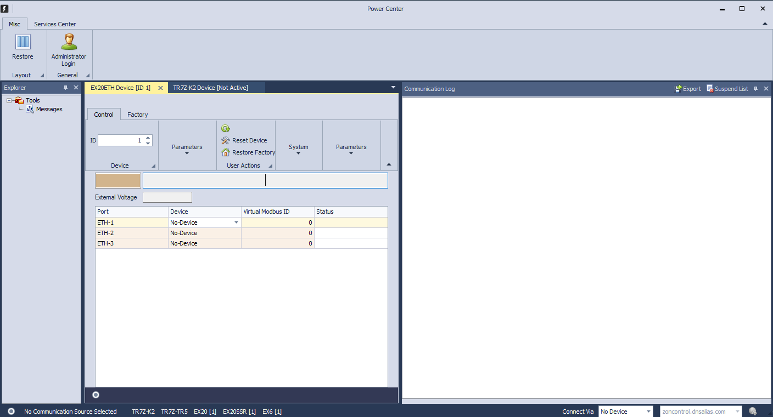
What is Power Center?
The Power Center system enables necessary operations on the unit, such as: unit configuration, communication settings, version updates and communication settings with external devices. In addition, the unit serves as a technical means for diagnosing problems and communicating directly with the unit.

Slide 3
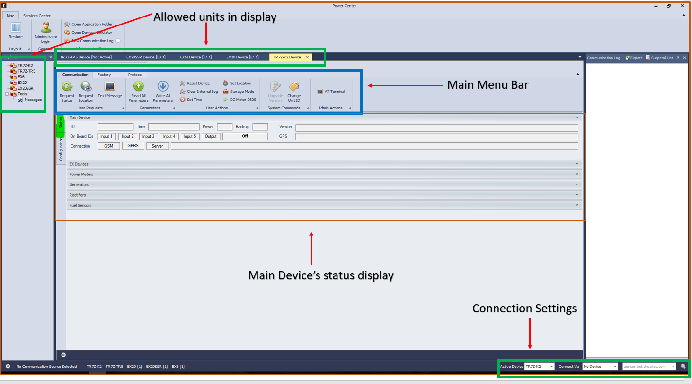
TR7z – k2 Status Screen

Slide 4
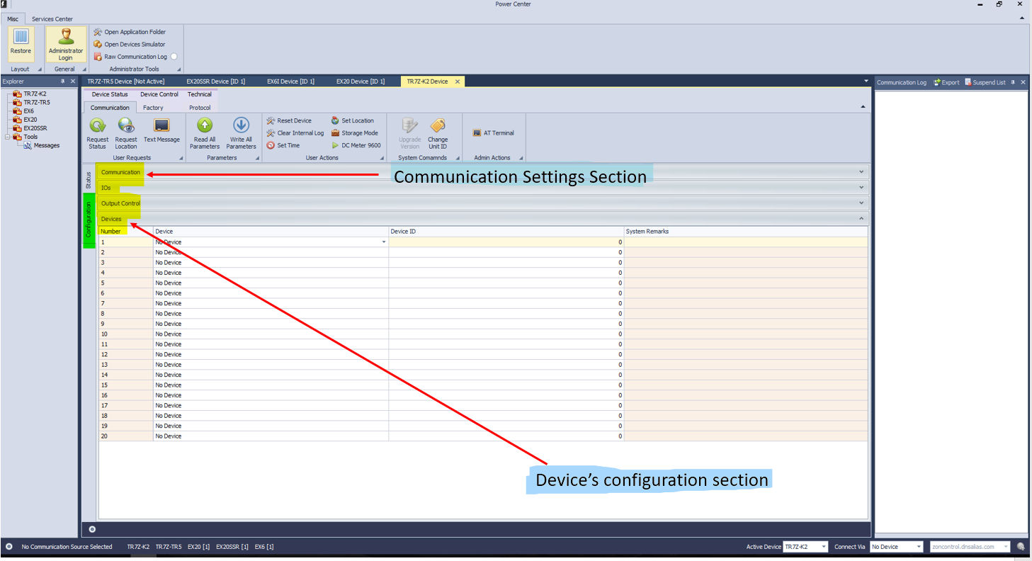
TR7z – k2 Configuration Screen

Slide 5
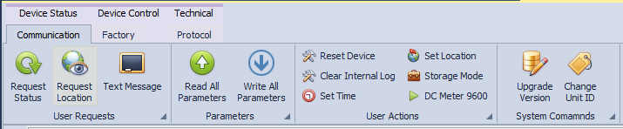
TR7z – k2 Communication Main Menu
Request Status – updates status and details.
Request Location – updates location of the selected unit
Text Message – send SMS from unit to mobile phone (unit’s SIM card should be SMS enabled)
Read All Parameters – reads settings from unit to Power Center.
Write All Parameters – Writes settings from Power Center to unit (“save changes” button).
Reset Device – initializes the unit.
Clear Internal Log – deletes internal storage log on unit
Set time – enables to set the unit time manually.
Set Location – enables to set unit’s location manually (in case of lack of GPS reception).
DC Meter 6900 – automatic check for DC Meter’s baudrate (relevant for TR7ZK2 units ver 3.21 and up only).
Upgrade Version – used for unit firmware version upgrade in serial connection.

Slide 6
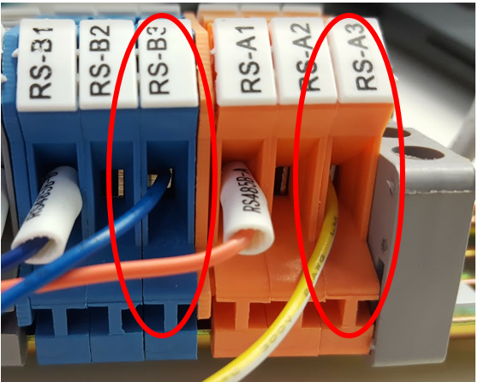
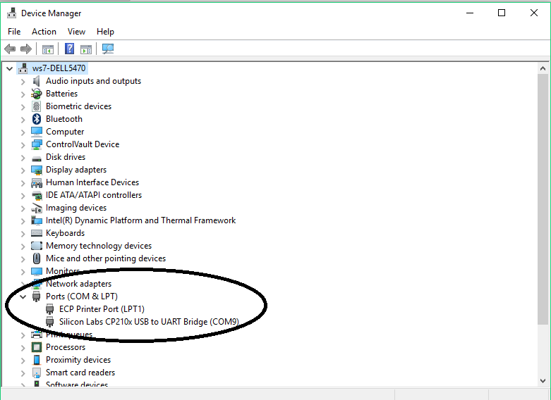
Connecting to Computer
Serial Connection to Power Center
A wire (T+) – connecting to input 18 in the corona
B wire (T-) – connecting to input 17 in the corona
Connect RS485 converter to your PC via USB. Verify PC recognizes the port

Slide 7
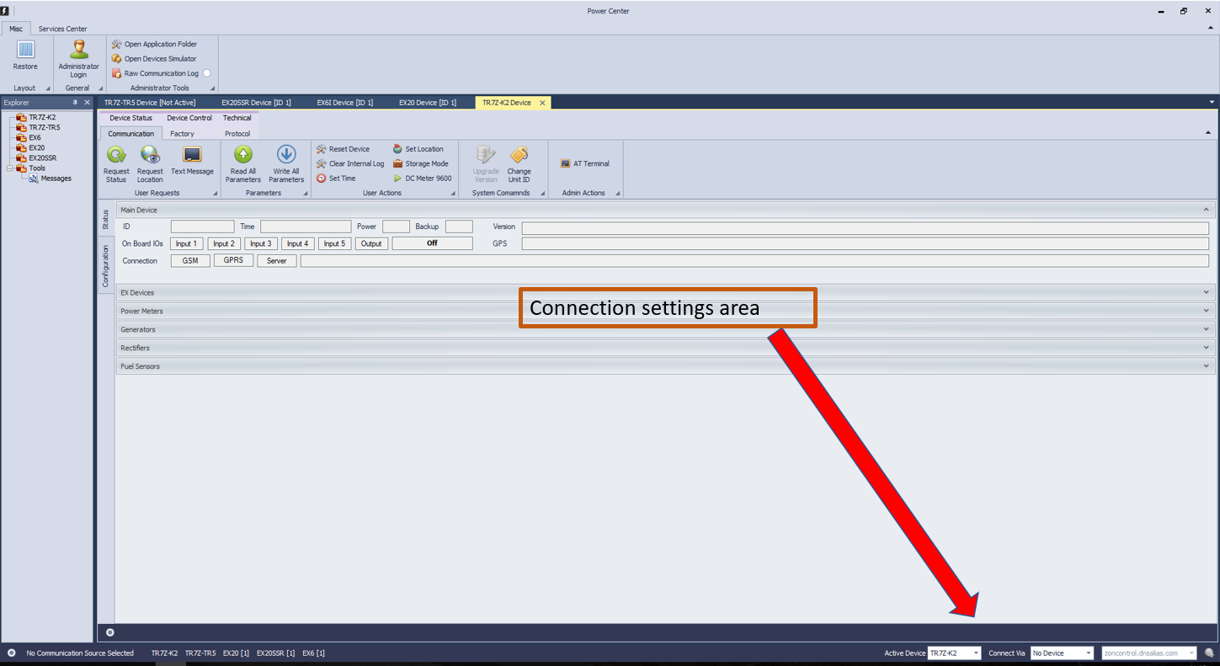
Connecting to Power Center
Serial Connection to Power Center
In the “Connect Via” (at the right-hand side of the bottom of the main screen) choose “Serial COM#
If your organization using both TR5 & TR7Z-K2 units, you should choose the relevant Active Device (Active Device refer to main unit only (not EX’s).

Slide 8
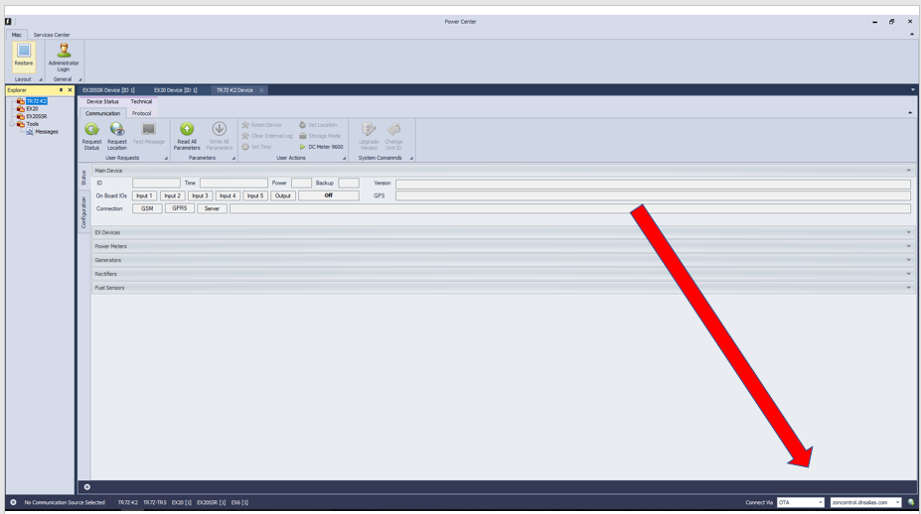

Connection to Unit
OTA Connection to Power Center
On the left rectangle choose the Active Unit
On the middle rectangle choose OTA.
On the right rectangle, choose the relevant server of your organization

Slide 9
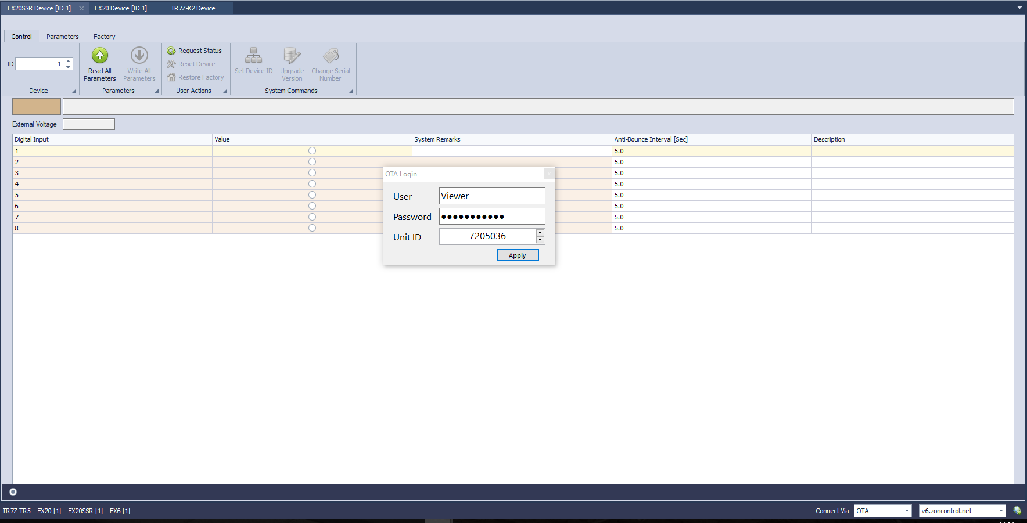
Connection to Unit
OTA Connection to Power Center
OTA Login pop up window – in this window we set which unit we wish to see its current parameters
Insert your ZON Control User name and password
insert the unit ID you wish to read

Slide 10
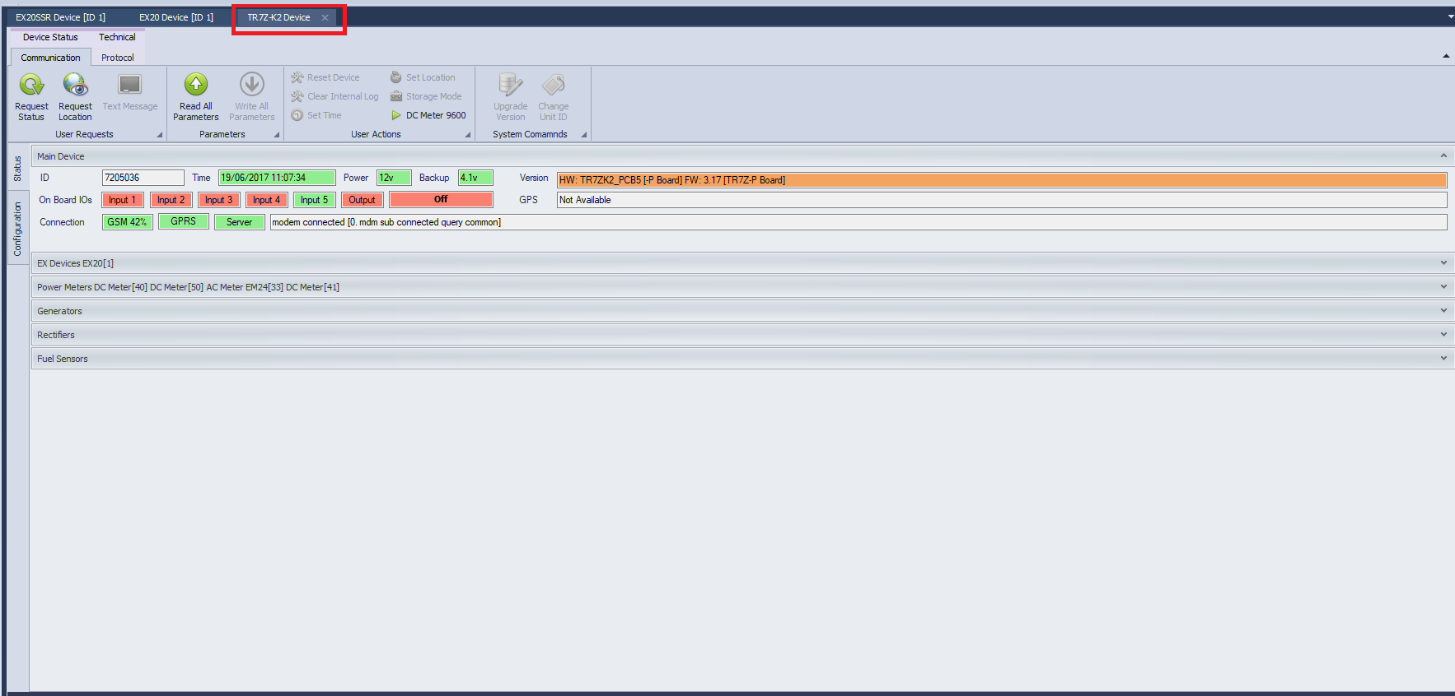
Connection to Unit
OTA Connection to Power Center
Choose TR7Z-K2 Device, and wait till the unit’s parameters are loaded

Slide 11
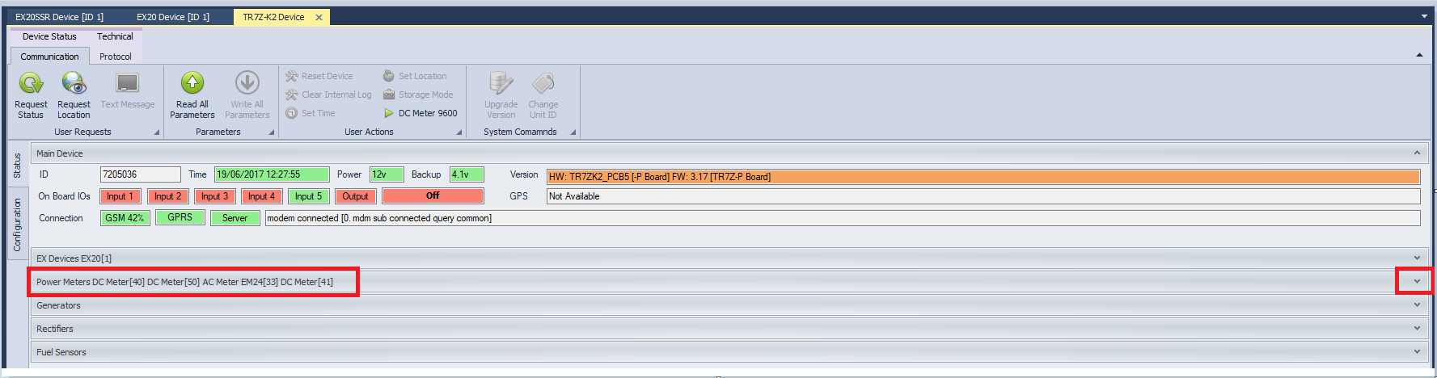
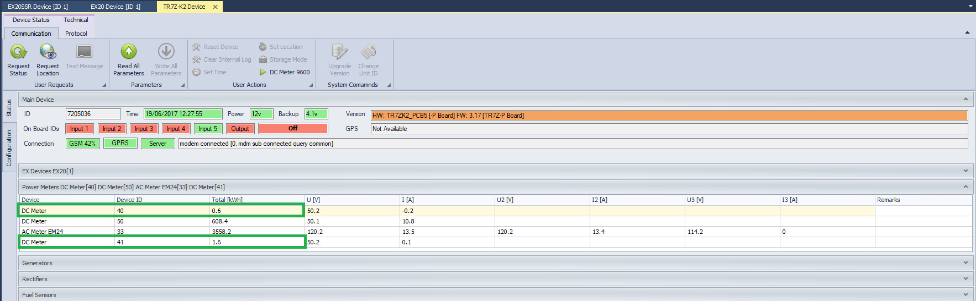
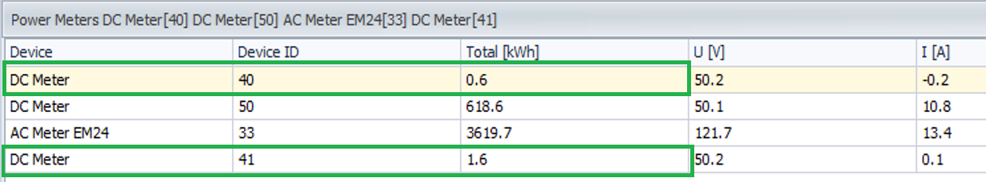
Parameters View
OTA Connection to Power Center

Slide 12
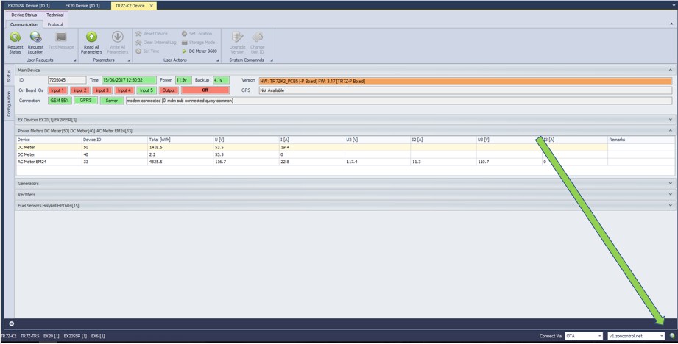
Switching Units
OTA Connection to Power Center

Slide 13
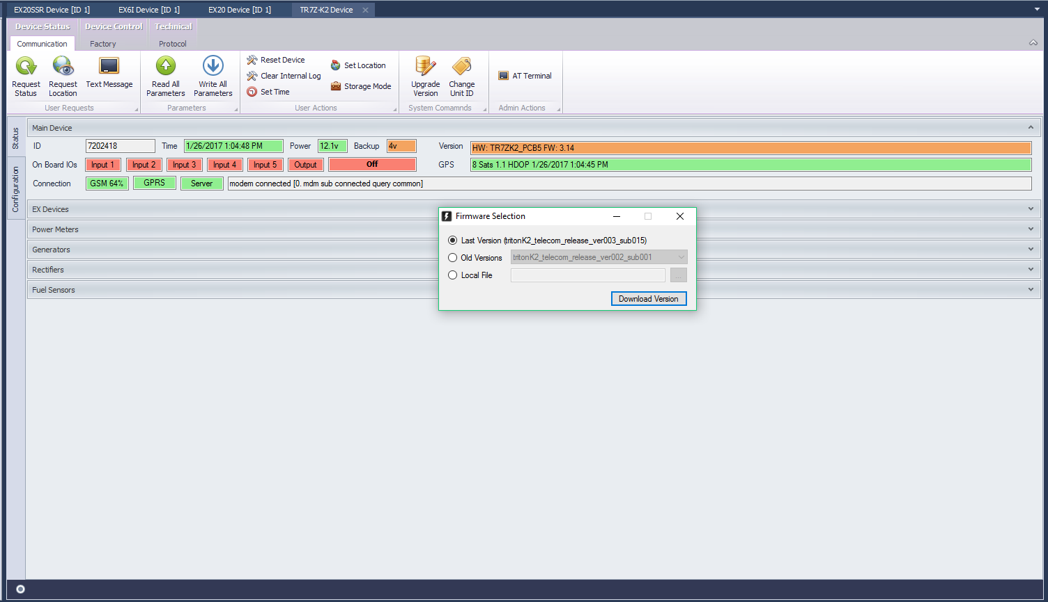
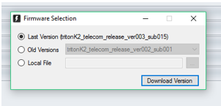
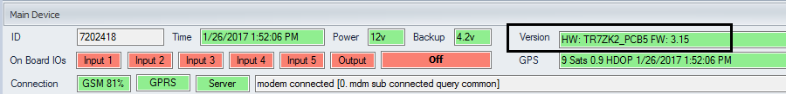
Unit Version Upgrade via Serial Connection

Slide 14
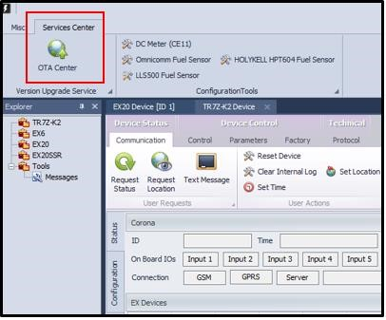
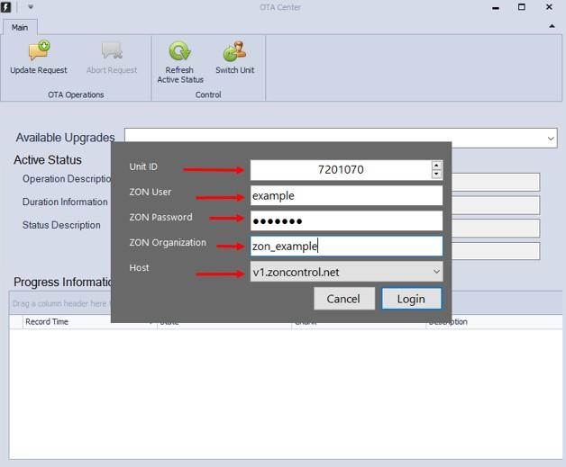
Unit Version Upgrade via OTA Connection
Insert ZON Control Credentials
Navigate to OTA Center

Slide 15
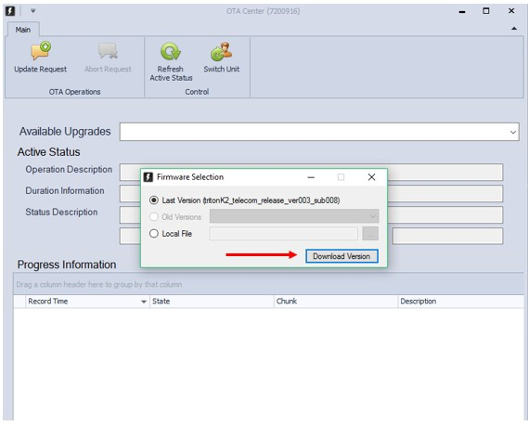
Unit Version Upgrade via OTA Connection
Press “Update Request” button
Choose Latest Version
Click Download Version

